Slide 1

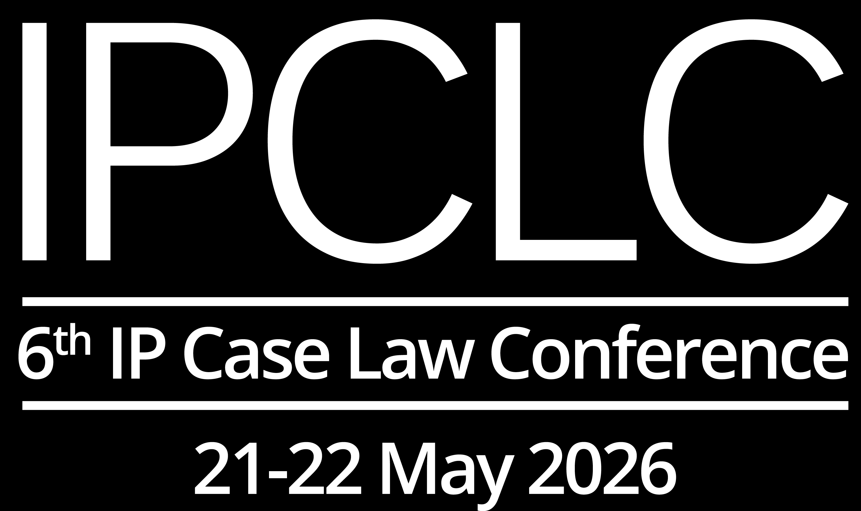
Walking the Line:
When Using a Mark in Altered Form Counts
Dr. Anke Nordemann-Schiffel, maître en droit
Rechtsanwältin, NORDEMANN, Berlin
21 May 2026

Slide 2
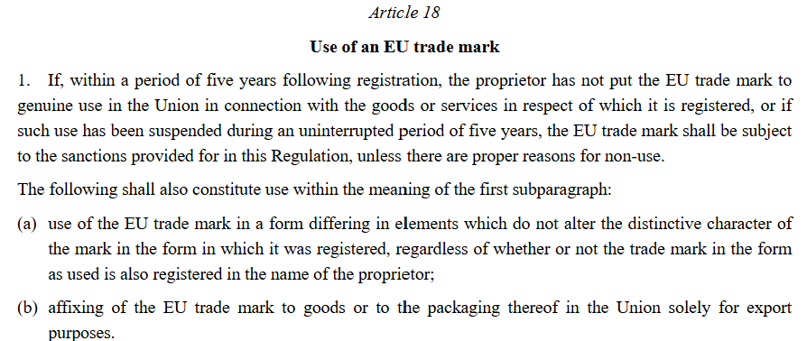
Use of an EU trade mark in altered form: Art. 18 (1)(a) EUTMR

Slide 3
Use of a Trade Mark in Altered Form: General Principles
Trade marks are not used in isolation: product information, other trade marks, symbols, images, colouring, …
enable trade mark owner to adapt trade mark to marketing and sales requirements
Genuine use (+) if `broadly equivalent´
EUIPO Guidelines, Part C, Section 7, Chapter 6.2.1.
CP 8 (Oct. 2020), https://euipo.europa.eu/tunnel-web/secure/webdav/guest/document_library/contentPdfs/about_euipo/who_we_are/common_communication/common_communication_cp8_en.pdf

Slide 4
Use of a Trade Mark Together with Another Trade Mark
≠ Use as registered but together with another mark
  Simultaneous use of independent marks that are perceived as such: Art. 18 (1) 1st subpara. EUTMR

Slide 5
Use of a Trade Mark Together with Another Trade Mark
Word mark GENUSSLÄNDER
Perceived as trade mark or as indication of type
of cheese ?
GC, 28 January 2026, T-46/25

Slide 6

Germany: Bundesgerichtshof, judgment of 20 November 2025, I ZB 30/25 – H15 / Hecht H15
Registered prior trade mark: H 15
„H 15“ and „GUFIC“ perceived as independent signs ?
BGH: only if both are perceived as trade marks = indications of origin, not just product names

Slide 7
Use in a Form Differing from the Registration
  Genuine use (+) if no alteration of the registration´s distinctive character
    Additions
    Omissions
    Changed appearance

Slide 8
Use in a Form Differing from the Registration
Word mark PHARMOS NATUR
Use as
EUIPO, 4th BoA, 8 April 2026, R 1128/2025-4 and R 1160/2025-4

Slide 9
Use in a Form Differing from the Registration
Registration for figurative mark
Use as
EUIPO, 1st BoA, 31 March 2026, R 952/2025-1 and R 930/2025-1

Slide 10
Use in a Form Differing from the Registration
Use in a form differing from the registration
  the registration´s distinctive character may be altered if change of distinctive or of elements that make mark distinctive
    used as and
EUIPO, 2nd BoA, 5 March 2026, R 1020/2025-2

Slide 11
Use in a Form Differing from the Registration
Registration for word mark BRUGMAN and for semi-figurative mark
Use as
EUIPO, 1st BoA, 13 March 2026, R 1003/2025-1

Slide 12
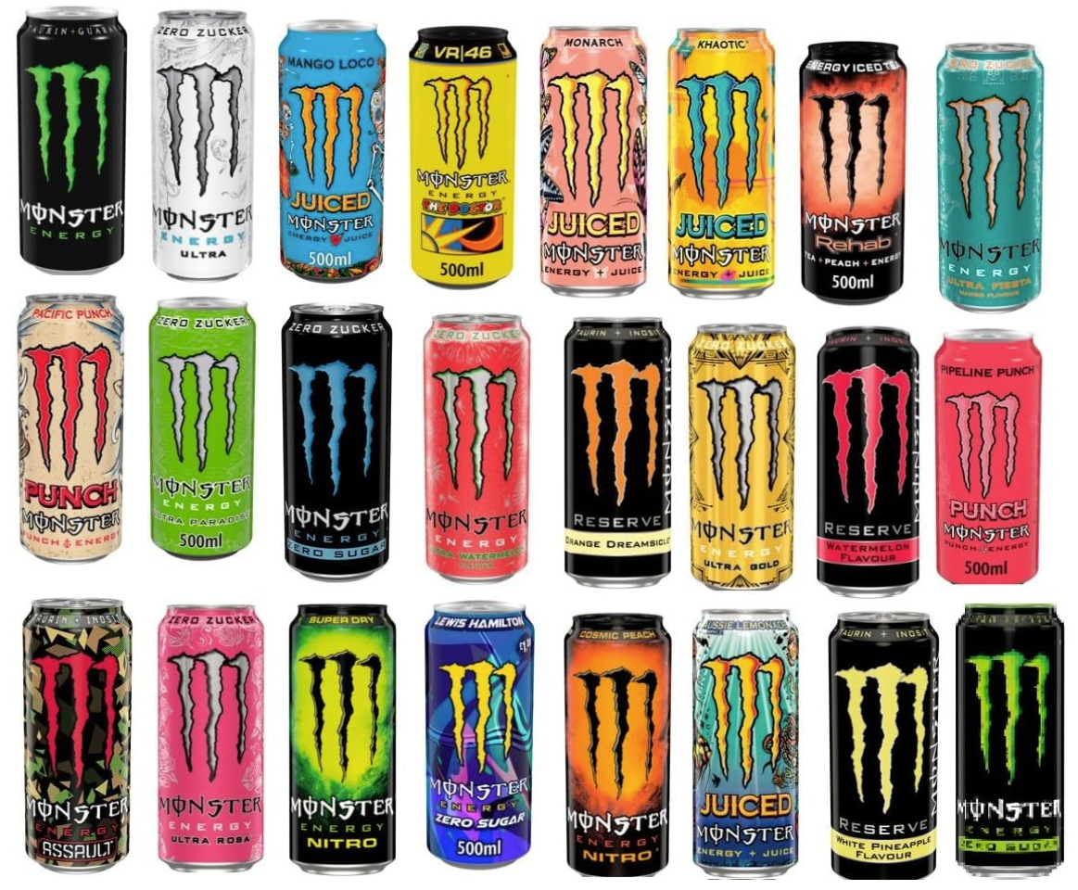

Germany: Federal Patent Court, judgment of 23 August 2024, 30 W (pat) 78/21 - MONSTER
Genuine use of the German word mark „MONSTER ENERGY“?

Slide 13
THANK YOU

